Slide 1
WELCOME
WELCOME

Slide 2
Instructor:
Dr.Md.Nawab Yousuf Ali
Professor,Department of
Computer Science &Engineering
Group Members:
Mahmud Jamil
(ID:2017-2-60-147)
Farhat Jebin
(ID:2017-2-60-059)
Nishat Tasmim Madhu
(ID:2017-2-60-097)
CSE442 Microprocessors
&
Microcontrollers

Slide 3
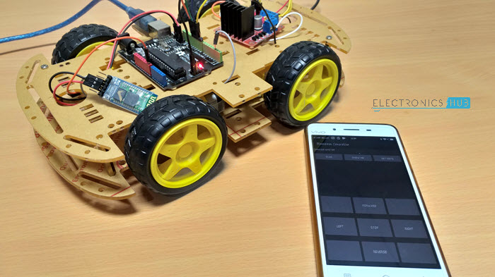
Smartphone Android operated Robot using Arduino

Slide 4
AIM IN OUR PROJECT
The project aims in designing a Robot that can be operated using Android mobile phone.

Slide 5
INTRODUCTION
In this project, we are going to learn How to make a Mobile controlled Robot using the Arduino microcontroller. We will be controlling robots using a mobile app using Bluetooth and monitoring the system.

Slide 6
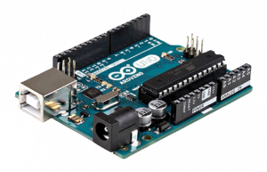
HARDWARE
ARDUINO
Arduino is an open-source prototyping platform used for building electronics projects. It consists of both a physical programmable circuit board and a software, or IDE (Integrated Development Environment) that runs on your computer, where you can write and upload the computer code to the physical board.

Slide 7
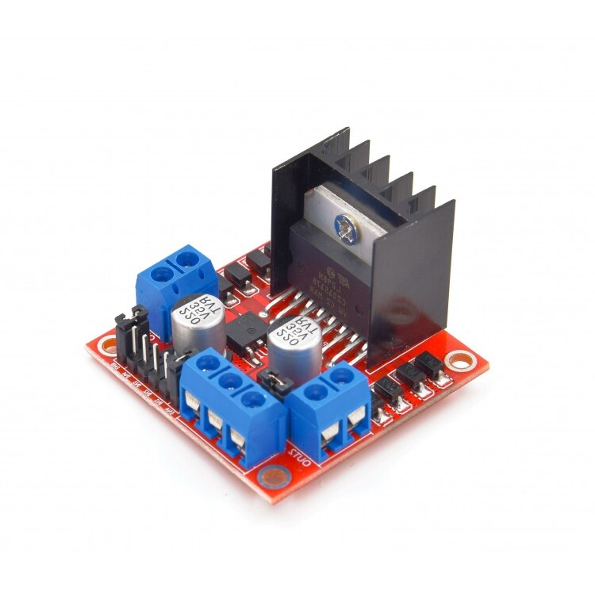
L298N Motor Driver
The L298N Motor Driver Module is responsible for providing the necessary drive current to the motors of the robotic car. I have provided information about L298N Module in an earlier project called Arduino DC Motor Control using L298N

Slide 8
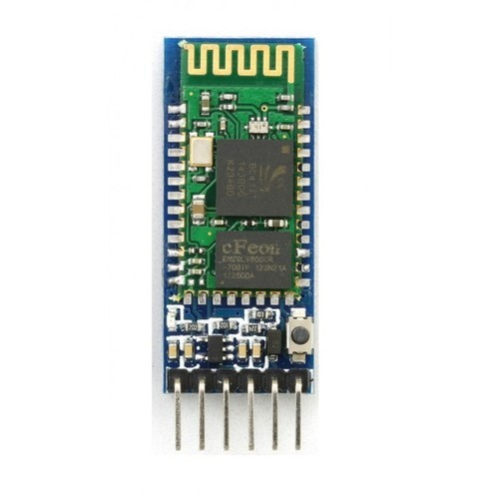
HC-05 Bluetooth Module
The HC-05 Bluetooth Module is responsible for enabling Bluetooth Communication between Arduino and Android Phone.

Slide 9
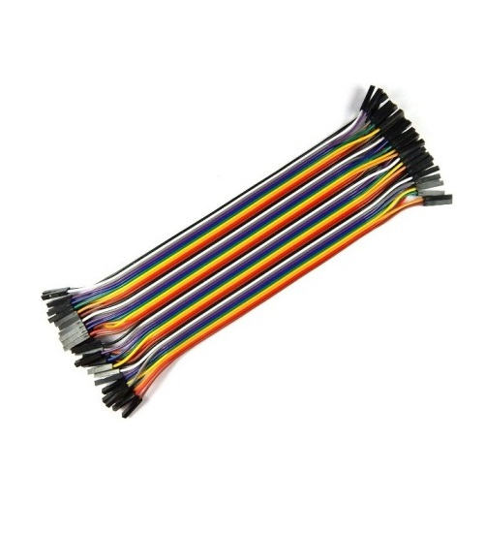
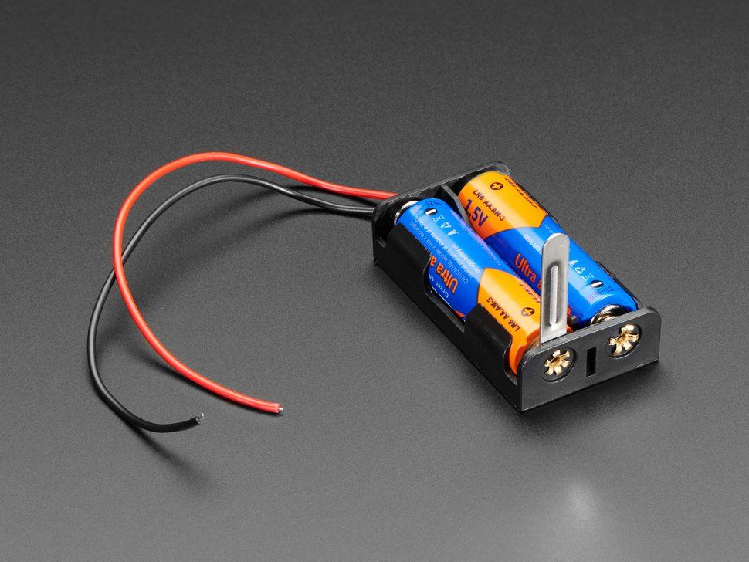
Connecting Wires
Battery & Holder

Slide 10
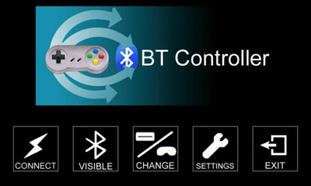
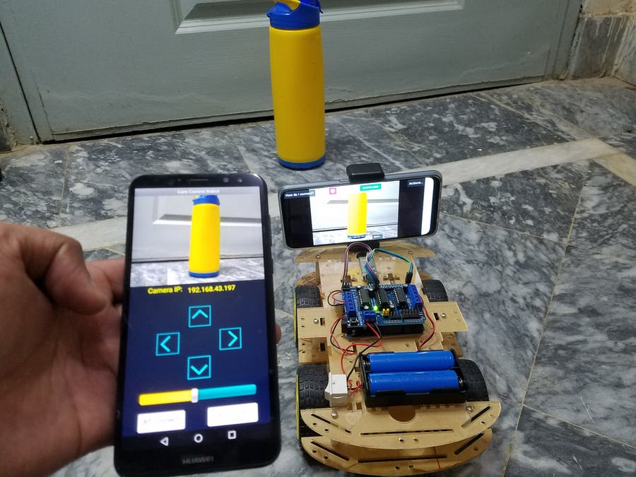
Bluetooth Controller APP
SMARTPHONE

Slide 11
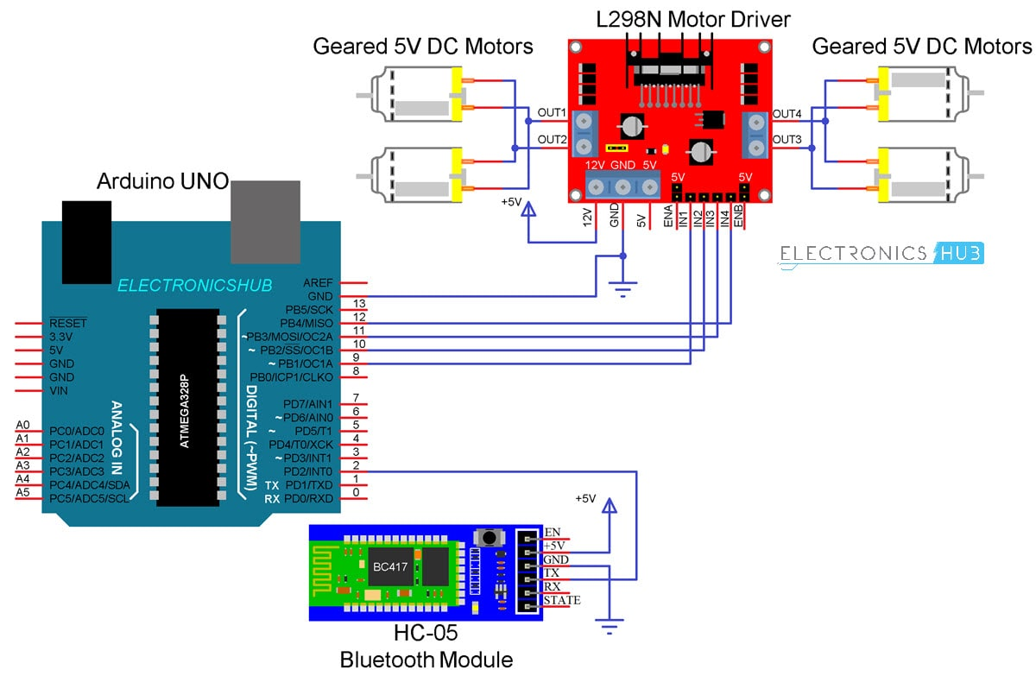
Circuit Diagram of Bluetooth Controlled Robot

Slide 12
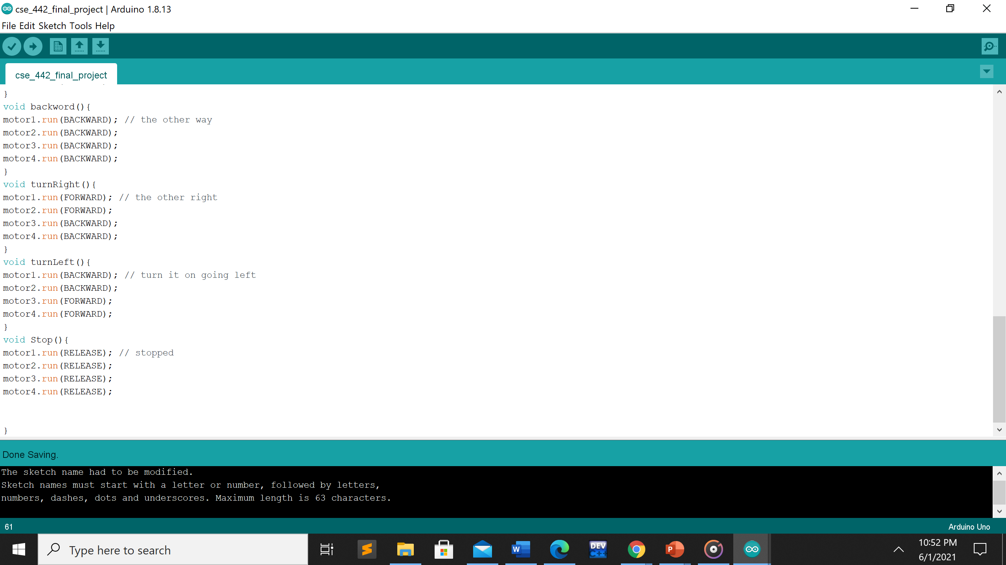
DIREECTION CONTROL CODE

Slide 13
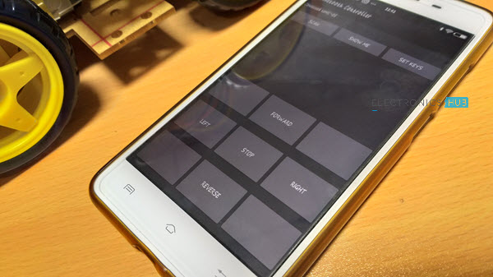
Working process
In the Android App, we have used 5 keys as Forward, Reverse, Left, Right and Stop. The corresponding data associated with each key is as follows:
Forward – 1
Reverse – 2
Left – 3
Right – 4
Stop – 5

Slide 14
Limitations
As the range of the Bluetooth Communication is limited (a maximum of 10 meters for class 2 devices for example) the control range of Bluetooth Controlled Robot is also limited.
Make sure that sufficient power is provided to all the modules especially the Bluetooth Module. If the power is not sufficient, even though the Bluetooth Module powers on, it cannot transmit data or cannot be paired with other Bluetooth devices

Slide 15
APPLICATIONS
Low range Mobile Surveillance Devices
Military Applications (no human intervention)
Assistive devices (like wheelchairs)
Home automation

Slide 16
THANK YOU

